Slide 1

SMART BANDWIDTH MONITOR

Slide 2
INTRODUCTION
The Smart Bandwidth Monitor is a Java-based application designed to monitor and analyze network bandwidth usage in real-time.
It provides detailed insights into download/upload speeds, total data usage, latency, and packet loss. This tool is essential for users who want to optimize their network performance and avoid overages.
The system displays the data in a user-friendly interface and provides real-time statistics through visual graphs.

Slide 3
PROBLEM STATEMENT
With the growing reliance on internet connectivity, users often face issues like fluctuating speeds, high latency, and packet loss. Existing network monitoring tools are often complex or lack real-time visualization. There is a need for a simple, user-friendly system to monitor, display, and analyze key network metrics (such as download/upload speeds, latency, and packet loss) to help users troubleshoot and optimize their internet connections effectively. The "Smart Bandwidth Monitor" addresses this gap.

Slide 4
ObjectiveS
Real-time monitoring of download/upload speeds.
Display of total data usage (downloaded/uploaded).
Latency and packet loss tracking.
Public IP and ISP information.
Graphical representation of network traffic."

Slide 5
TECHNOLOGIES USED
Core: Java SE, Java Swing (GUI).
Networking : TCP Sockets, java.net, ipinfo.io
API : Java networking API’s
OS – Level Stats
Linux: /proc/net/dev .
Windows : netstat –e, Powershell

Slide 6
SYSTEM ARCHITECTURE
Client Represents the user interface (UI) of the application. Java Swing UI Displays real-time network statistics Graphical representation of data
Server: Handles communication between the client and the network monitor. Java-based server Manages client requests Sends network data to the client
Network Monitor Collects real-time network statistics. Fetches download/upload speeds Calculates latency and packet loss Uses platform-specific commands (e.g., netsh, nmcli)
External APIs Fetches additional information like Public IP and ISP. Fetches Public IP and ISP information Uses ipinfo.io API

Slide 7
WORK FLOW
Client → Server: The client sends requests to the server for network data.
Server → Network Monitor: The server requests real-time network statistics from the network monitor.
Network Monitor → Server: The network monitor sends the collected data to the server.
Server → Client: The server sends the processed data to the client for display.
Network Monitor → External APIs: The network monitor fetches Public IP and ISP information from external APIs.

Slide 8
Technical Details
Real-Time Monitoring:
Uses NetworkMonitor to track download/upload speeds, latency, and packet loss.
The client sends data to the server every 2 seconds using scheduled tasks (ScheduledExecutorService).
UI Representation:
Java Swing is used to create a user interface that displays the bandwidth statistics and graphical representation.
BandwidthGraph class draws real-time download and upload graphs.
Data Formatting:
Data is formatted to display download/upload in KB/s, and total data is shown in KB/MB/GB.

Slide 9
Bandwidth Graph Visualization
The BandwidthGraph class visualizes both download and upload speeds in a line graph.
The graph is updated every second and is scaled dynamically based on the maximum observed
values.
Color-coded lines represent:
Blue Line: Download Speed
Red Line: Upload Speed
The graph updates in real-time, displaying the latest dat

Slide 10


Client-Side Code (BandwidthMonitorClient)
This is the part where Java Swing UI communicates with the server and monitors network performance.
connectToServer()
This method connects the client to a remote server via a TCP Socket.
Create a Socket to connect to the server.
The Socket object is used to establish a connection with the server at the specified IP (SERVER_ADDRESS) and port (SERVER_PORT).
The ObjectOutputStream allows sending Java objects over the network, and ObjectInputStream reads objects sent by the server.

Slide 11
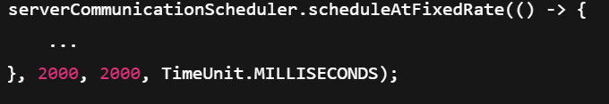
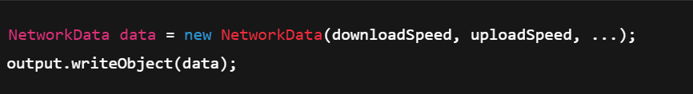
Scheduled Task to send data at regular intervals (every 2 seconds):
This code sends data to the server periodically, every 2 seconds.
Gather network data (download/upload speed, latency, packet loss) and send it to the server.
The data is collected from UI elements (e.g., totalDownloadedLabel, totalUploadedLabel, etc.).
This data is sent to the server as a NetworkData object:
java

Slide 12
onNetworkDataUpdated()
This method is called whenever new network data (e.g., speed, latency, packet loss) is received from the server.
1: The data is used to update the UI with the new stats.
The download/upload speeds are formatted and displayed as labels in the UI.
Latency and packet loss are updated on the UI as well.
Data is displayed in human-readable units (KB, MB, GB).
2: Graph Update:
The download and upload speeds are added to the downloadSpeedHistory and
uploadSpeedHistory lists.
These lists store the most recent data points to plot the graph.
The graph (bandwidthGraph.updateData) is updated with the new values, and old values are removed if the list size exceeds HISTORY_SIZE.

Slide 13
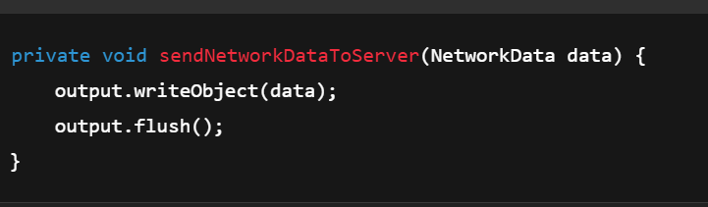
sendNetworkDataToServer(NetworkData data)
Key Task: Sends the collected network data to the server.
Explanation: This method serializes the NetworkData object and sends it to the server via an ObjectOutputStream.
It ensures that the server receives the latest performance metrics of the client’s internet connection.

Slide 14
formatDataSize(long sizeInKB)
Key Task: Converts the size of data into a human-readable format.
Explanation: This method formats the raw data (in KB) into a more understandable format (e.g., KB, MB, GB)
to display total data uploaded and downloaded.
updateNetworkInfo()
Key Task: Retrieves network information like the public IP, ISP, and Wi-Fi SSID.
Explanation: This method calls APIs to fetch the client’s public IP address, ISP info,
and current Wi-Fi connection details. The gathered information is then displayed on the UI.

Slide 15
Server-side code (BandwidthMonitorServer) :
1. handleClientConnection()
Key Task: Listens for incoming client connections.
Explanation: This method listens for new incoming client connections on a specified port. Once a client connects,it sets up input and output streams to communicate with the client, waiting for the network data.
2.processNetworkData(NetworkData data)
Key Task: Processes the network data sent from the client.
Explanation: This method is responsible for handling the network data sent by the client. It extracts and logs the data (download/upload speeds, latency, packet loss, etc.) for monitoring and analytics purposes.

Slide 16
3. sendAcknowledgement(ObjectOutputStream output)
Key Task: Sends an acknowledgment back to the client after receiving data.
Explanation: After the server receives data from the client, it may send an acknowledgment or
a response back to the client to confirm that the data was received correctly.
4. startServer()
Key Task: Starts the server and prepares it to accept client connections.
Explanation: This method initializes the server socket, binds it to a specific port, and continuously listens for
client connections. Once a client connects, it starts processing the data received from the client.
java
5. logNetworkData(NetworkData data)
Key Task: Logs the network data received from the client.
Explanation: This method logs the network performance data into a log file or database.
The logged data can be used for monitoring trends or troubleshooting network performance issues.
java

Slide 17
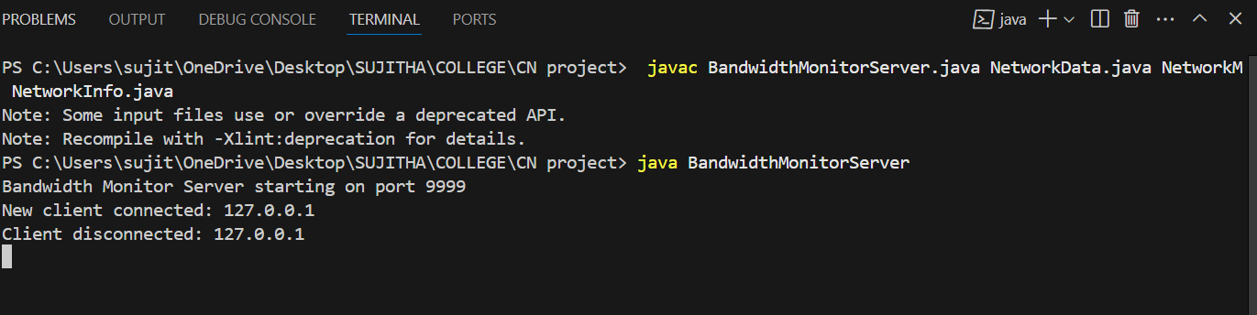
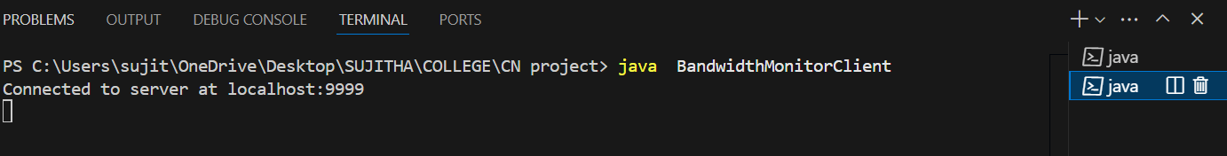
SCREENSHOTS

Slide 18
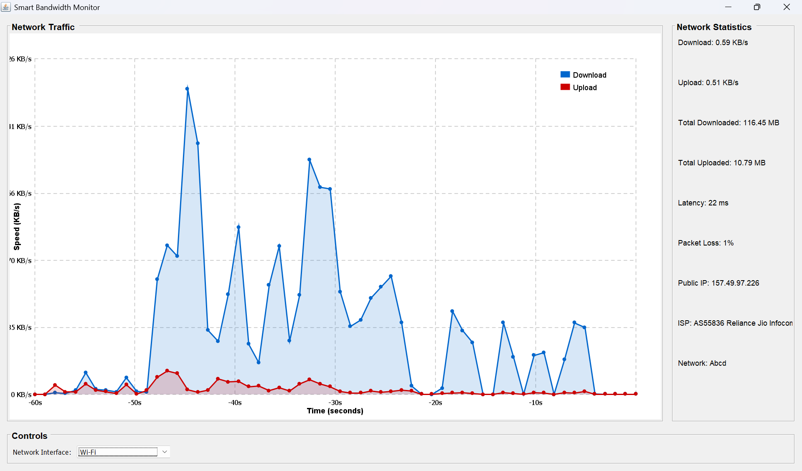

Slide 19
Challenges Faced
Real-Time Data Handling:
Ensuring smooth real-time updates in the UI was challenging.
TCP Communication:
Ensuring reliable communication between the client and server without packet loss.
Network Speed Variability:
Handling varying network speeds and ensuring that the UI updates accordingly.
Graphical Visualization:
Dynamically scaling graphs based on real-time data was a challenge.

Slide 20
Future Enhancements
Mobile Application:
Develop a mobile version of the app for monitoring bandwidth on the go.
Detailed Reports:
Provide detailed statistical reports and analysis over extended periods.
Advanced Analytics:
Add more advanced analytics (e.g., bandwidth trend analysis).
Alert System:
Implement automated alerts via email or SMS when network conditions degrade.

Slide 21
Conclusion
The Smart Bandwidth Monitor is an efficient tool for real-time monitoring of network bandwidth.
It provides valuable insights into internet performance, helping users and organizations to ensure stable and optimal network conditions.
References
Official Java Documentation: https://docs.oracle.com/javase/
ipinfo.io API: https://ipinfo.io
Java Swing: https://docs.oracle.com/javase/tutorial/uiswing/
TCP Sockets in Java: https://docs.oracle.com/javase/tutorial/networking/sockets/

